Slide 1
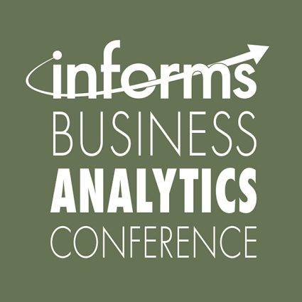



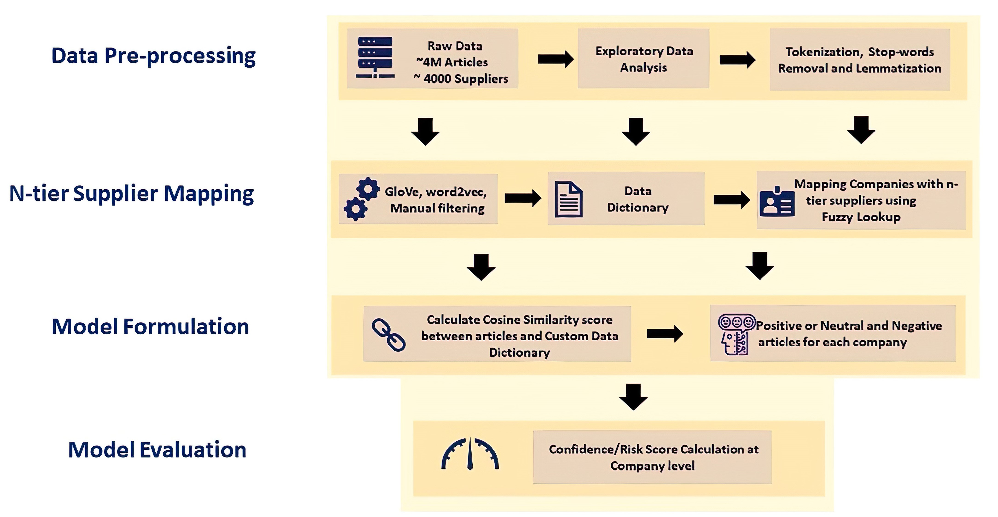

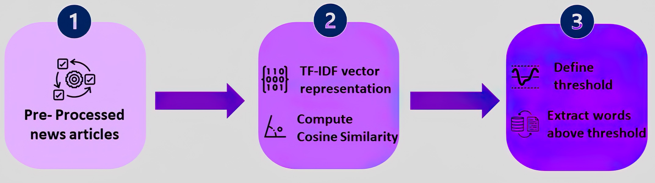
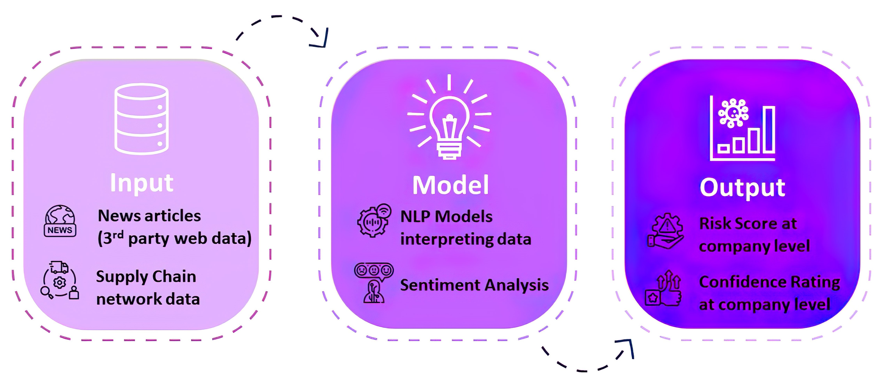


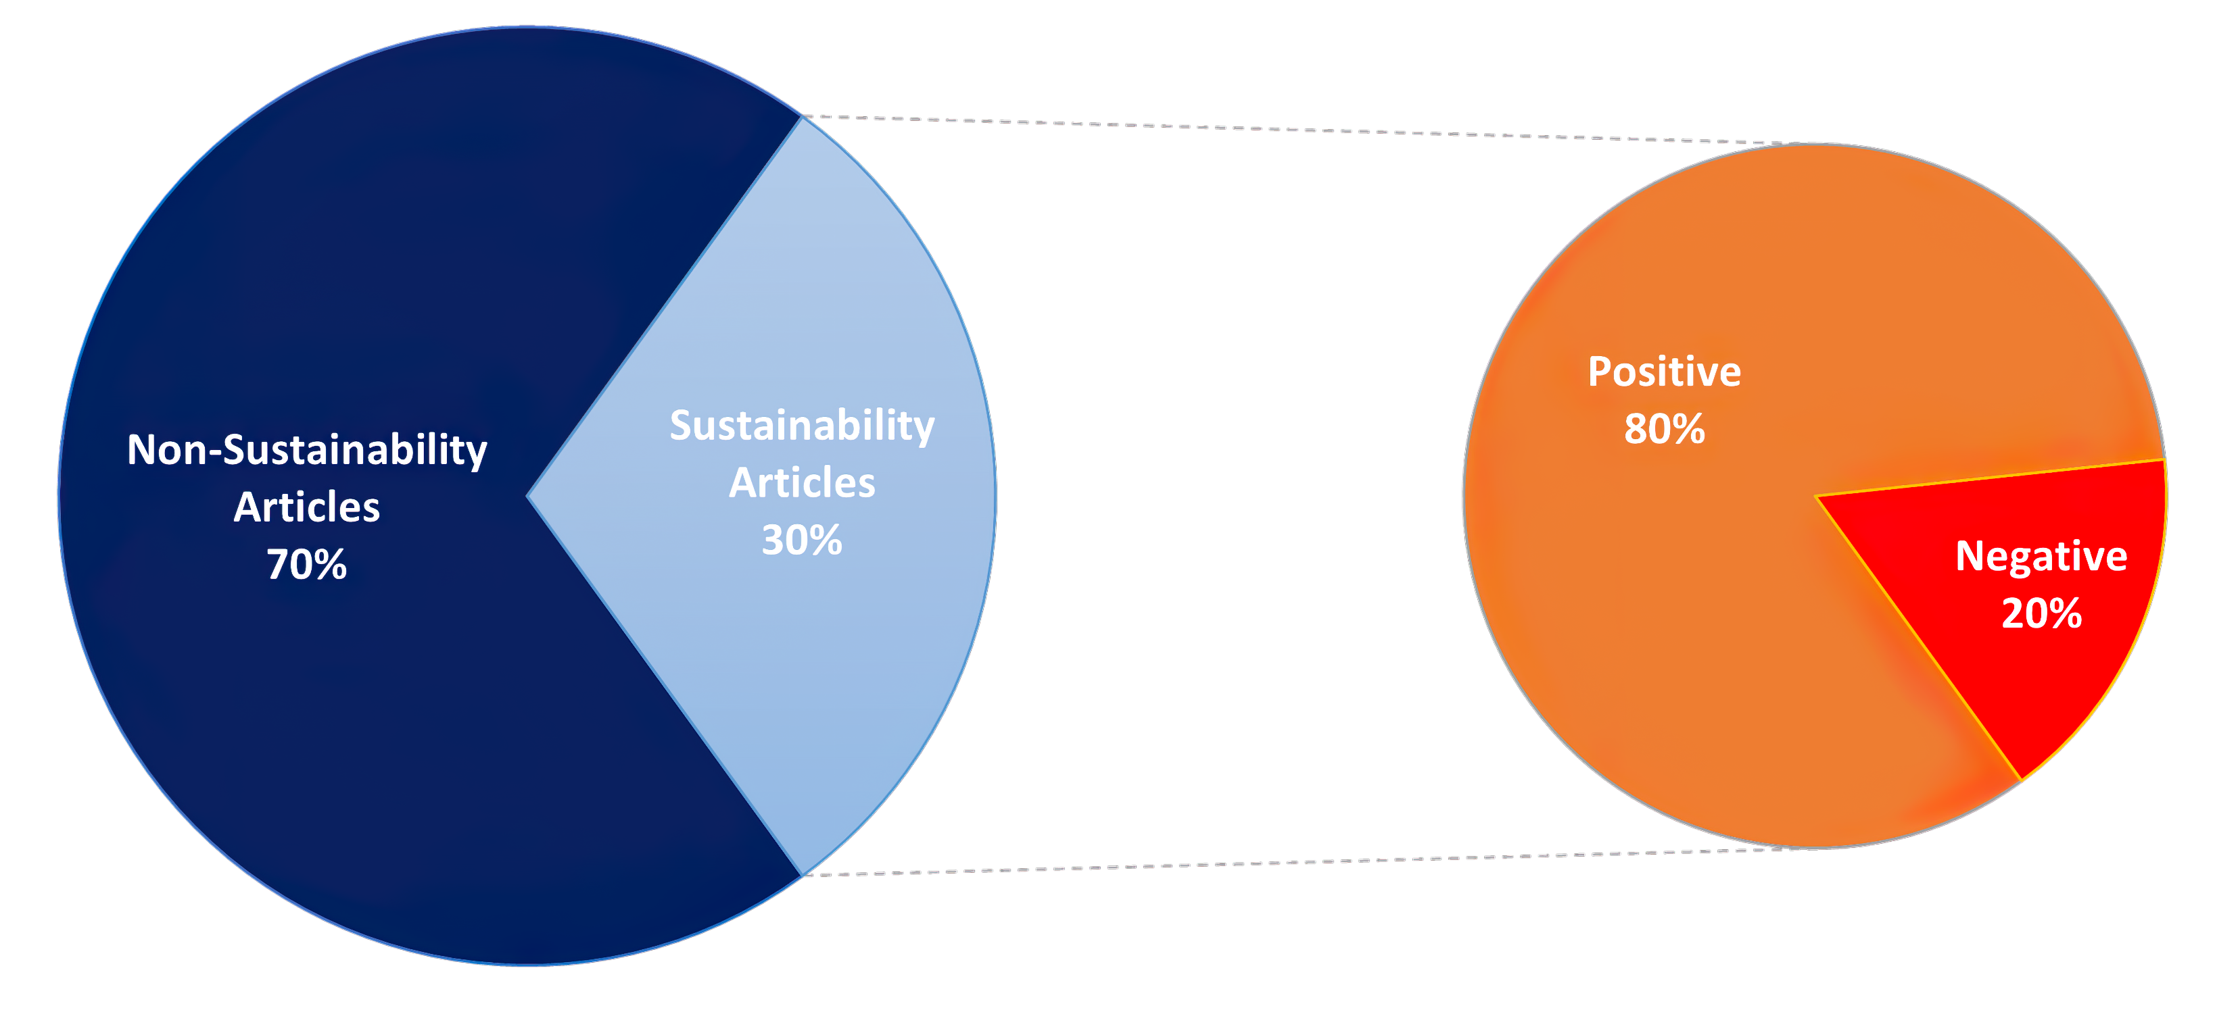

















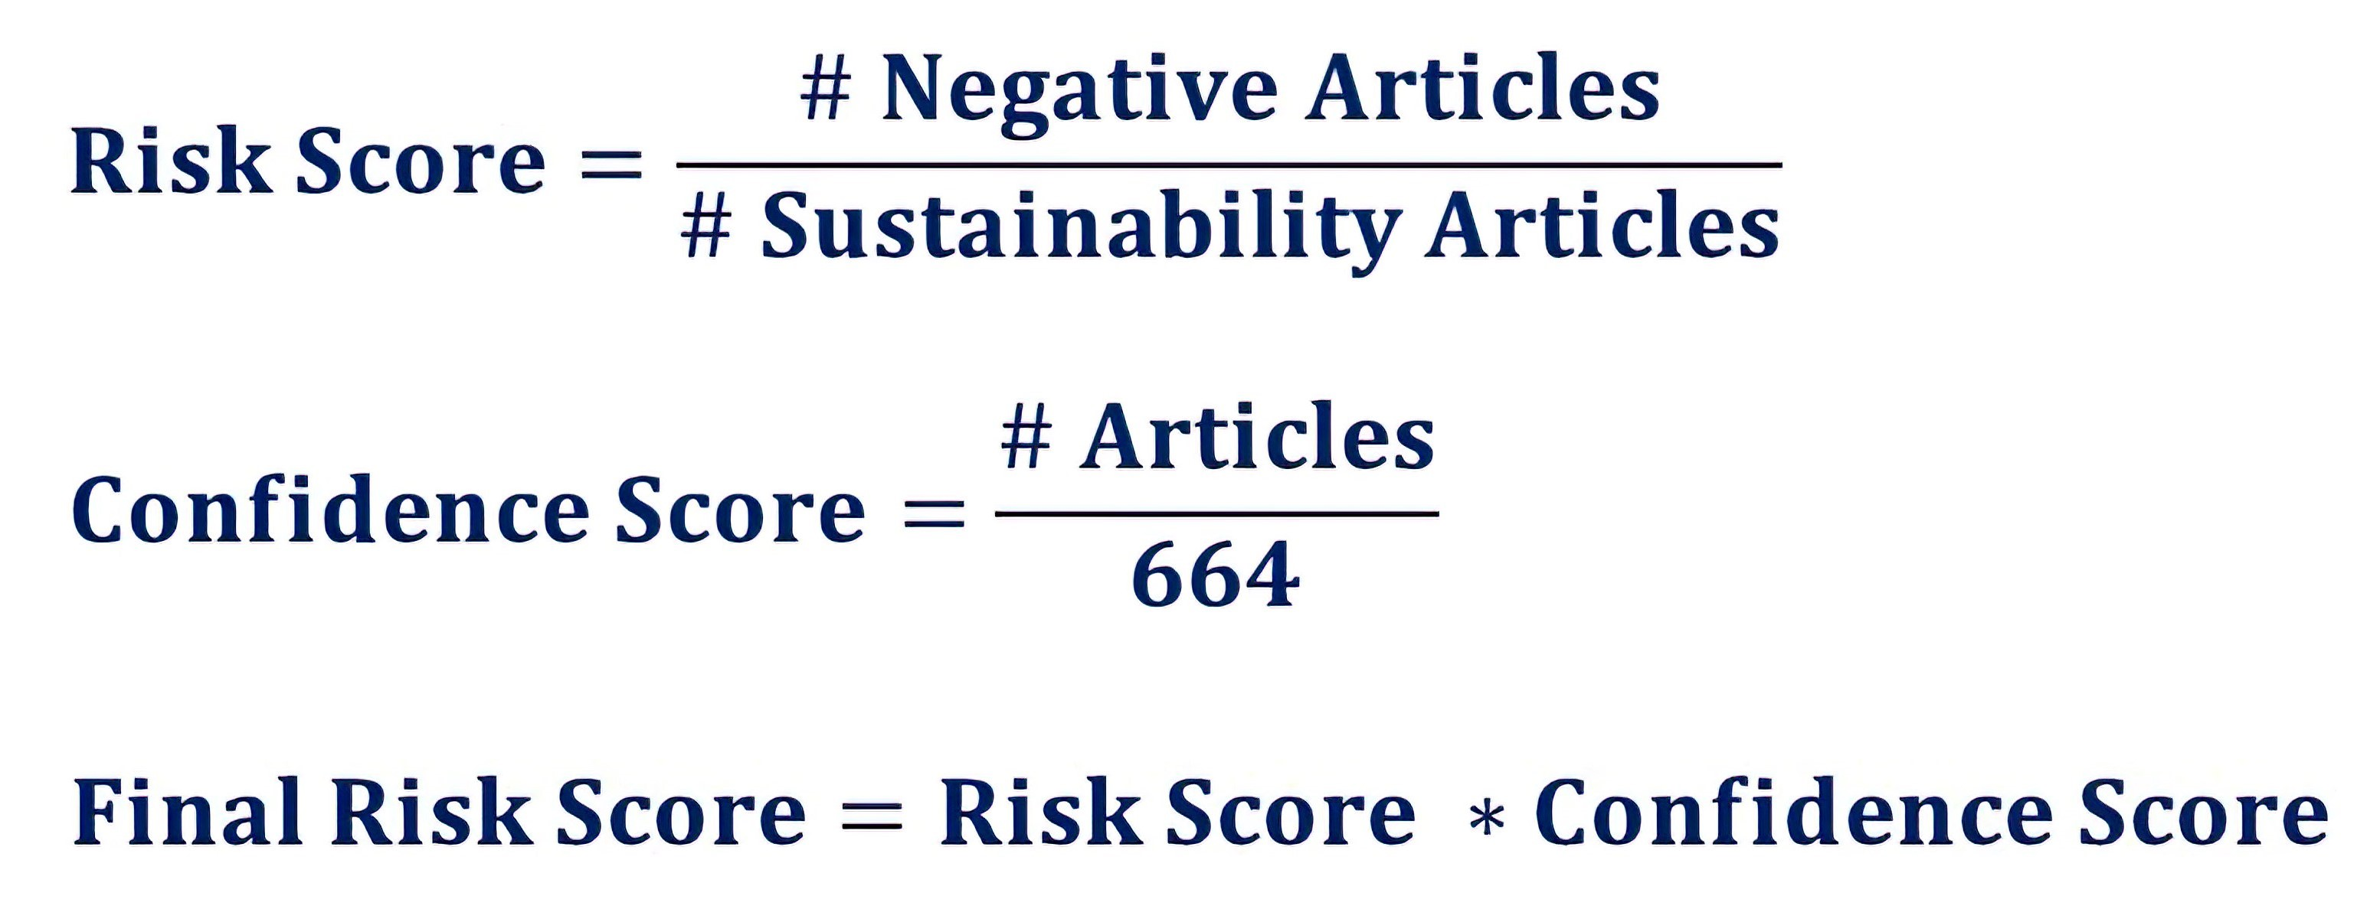








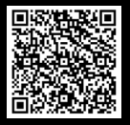

An NLP-Based Sustainability-Driven Approach to Modeling n-tier Supply Chain Resilience and Risks
Madhulika Chilla, Shaanu Gupta, Ricardo Nunez Magana, Mateo Posada, Ziyue Tang, Prof . Yang Wang
Purdue University, Daniels School of Business
mchilla@purdue.edu; gupta860@purdue.edu; rnunezma@purdue.edu; mposada@purdue.edu; tang422@purdue.edu; yangwang@purdue.edu
BUSINESS PROBLEM
RESEARCH QUESTIONS
METHODOLOGY
DEPLOYMENT AND LIFE CYCLE MANAGEMENT
Globalization and supply chain disruptions have led companies to reevaluate their sustainability and supply chain resiliency strategies. The lack of transparency in upstream and downstream data have prevented companies from acquiring optimal supply chain visibility.
These obstacles prevent businesses from:
Design an automated rudimentary approach that can be used to analyze and map the n-tier supply chain from external data sources
Identify and analyze articles related to sustainability using NLP
Cosine Similarity Theme Classification
ANALYTICS PROBLEM
Determining supplier reliability beyond tier 1
Classifying company articles as positive or negative based on content to calculate scores.
Evaluating company-supplier alignment
Evaluating risks based on suppliers' attributes
N-Tier Supply chain
DATA
MODEL BUILDING
Business
Partnered with a leading consulting firm specialized in supply chain and operations solutions to study ESG risks and supply chain resilience.
Word2vec
Neural Network to learn word associations from corpus of text to identify synonymous words
Tier 1
Tier 2
Tier 3
Custom Data
Dictionary
118 Words
CONCLUSION AND FUTURE SCOPE
Revolutionize Supply Chains: Smarter, Greener, Resilient
ESG Scoring
# OF ARTICLES ~4M​
GloVe NLP
Unsupervised learning algorithm for obtaining vector representations for words
Accuracy Rate ~ 70% in matching 5000 suppliers to their respective companies
Harness NLP for data-driven supplier selection, enhanced sustainability, and resilient supply networks
Analyze supplier articles to determine ESG scores, enhance transparency, and meet diverse supply chain needs
# OF SOURCES ~14K​
90 Words
# OF REGIONS ~900​
Approach helps monitor supply chain risks in real time to countermeasure the disruptions and threats
Private Data Repository
Literary Sources
# OF COMPANIES ~400K​
LDA Topic Modeling
Text classification of news articles to get sustainability topic
Most Articles < 2500 words
Cosine
Similarity
MATHEMATICAL EQUATION FOR ESG SCORE
Measure Textual Relationships
Efficiently compare text data with a data dictionary using Cosine Similarity. A score close to 1 indicates high similarity, ideal for uncovering connections, optimizing search results, and enhancing text mining
Relationship Extraction from news articles using BERT or other NLP techniques will accelerate the problem recognition and its solutions
Final Risk Score represents the companies' final sustainability risk.
BUSINESS BENEFITS
Improved Risk Identification by analyzing unstructured news articles to help companies take proactive measures to mitigate potential risks
ACKNOWLEDGEMENT
Fuzzy String Matching
We extend our sincere gratitude to our industry partner for their guidance and support on this project, as well as Prof. Yang Wang from Purdue's MS BAIM program for her invaluable guidance.
Estimate costs of potential supply chain disruptions and provide a timeframe for the company to develop contingency plans
Streamline Company-Supplier Matching
Fuzzy Lookup accurately matches companies to suppliers despite spelling variations, eliminating manual data matching, and saving time and effort for large datasets.
Insight into the likely emissions produced along the supply chain, to guide supplier selection based on the company's environmental mission.
Notes:
Conclusions color should be changed

